Slide 1
Introduction To transportation
Beiyu Lin

Slide 2
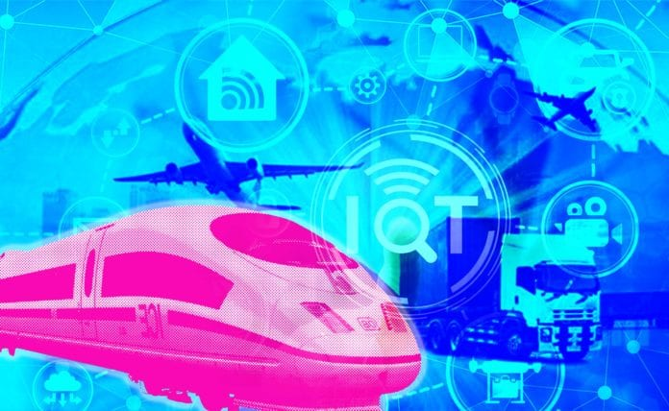
How iOT improves transportation
Assisted Driving
Dynamic Navigation
Optimized Maintenance
Expanded Ridesharing
Fleet Management

Slide 3
Why iot in transportation
The connected car market grew by 45% between 2018 and 2019 alone, with global shipments expected to pass 76 million units by 2023
It won’t be too long before connected cars are the norm. When this shift does happen, roads will be a safer and more convenient place for everyone.

Slide 4
iOT in transportation
Assisted Driving
Dynamic Navigation
Optimized Maintenance
Expanded Ridesharing
Fleet Management

Slide 5
Assisted Driving
Definition:
Driver assistance, also known as advanced driver-assistance systems (ADAS), are technologies used to make motor vehicle travel safer by automating, improving or adapting some or all of the tasks involved in operating a vehicle (link 1:04-2:10).

Slide 6
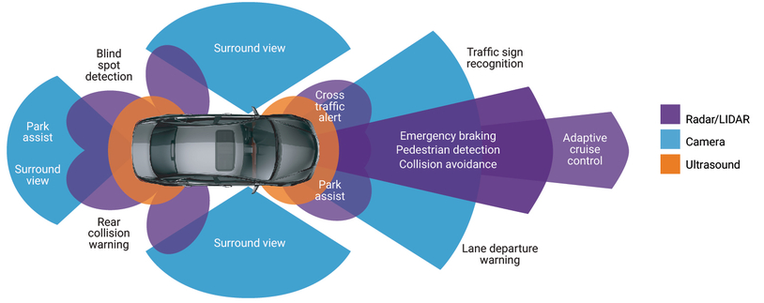
Assisted Driving

Slide 7
ASSISTED DRIVING
Challenges:
Technical: can be improved with new technologies, such as AI and machine learning
Ethical: hard to resolve
Example: difficult situations like occupant vs. pedestrian safety – moral questions
Current work:
Google partnership with General Motors and Ford
MIT’s Moral Machine

Slide 8
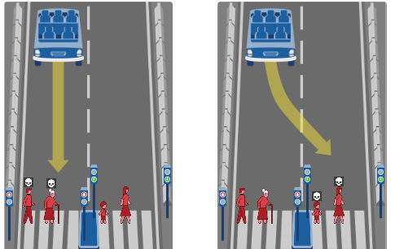
ASSISTED DRIVING
Ethical Dilemma:
What self driving car should do?
Ethical Dilemma in other fields?

Slide 9
ASSISTED DRIVING
Current methods:
Deep reinforcement learning (link)
Imitation learning (link 0:37-)

Slide 10
iOT in transportation
Assisted Driving
Dynamic Navigation
Optimized Maintenance
Expanded Ridesharing
Fleet Management

Slide 11
Dynamic Navigation
The improved navigation offered by IoT is useful to human drivers, too. Many people rely on GPS navigation, and IoT devices in vehicles could make these systems more helpful. Cross-car communication would allow navigation systems to account for real-time changes, like blockages or traffic jams.
Why not GPS?
Slow to adapt to traffic changes
IoT navigation offers real-time feedback.
Dynamic navigation (link 3:06 – 3:29 )

Slide 12
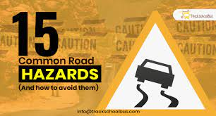
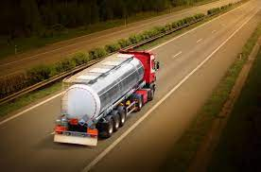
Why Dynamic Navigation
Examples
Hazards along a route can change in an instant
=> need dynamic navigation to avoid them
Examples
Environmental waste transport
=> need dynamic navigation to avoid them

Slide 13
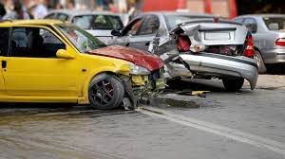
Dynamic Navigation
Examples
Traffic accidents
=> avoid risky traffic situations
IoT navigation can help them steer clear of congested areas or spots with high accident rates.

Slide 14
Dynamic Navigation
Current methods:
Deep Reinforcement Learning Dynamic Routing for Navigation (link 7:13 – 7:52 )
DRL: single targe and multi-target agent (link 4:51- 5:23)
LiDAR data (link 0:42 – 2:58)

Slide 15
iOT in transportation
Assisted Driving
Dynamic Navigation
Optimized Maintenance
Expanded Ridesharing
Fleet Management

Slide 16
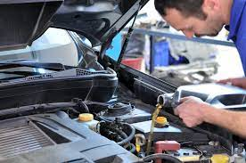
Optimized Maintenance
When should we change the oil?
How could we know when to do frequent vehicle maintenance?
IoT can help
Example (link: 0:04-1:08)

Slide 17
Optimized Maintenance
Current methods
Neural Network Classification (link 0.06- 0:13)
Sensor based (link: 0.54- 1:43)

Slide 18
iOT in transportation
Assisted Driving
Dynamic Navigation
Optimized Maintenance
Expanded Ridesharing
Fleet Management

Slide 19
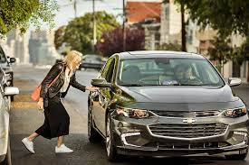
Expanded Ridesharing
Why Ridesharing is good?
able to transport people to and from anywhere
reducing traffic congestion and parking demand
eliminate vehicle emissions and creates less stressful commutes
How IoT helps?

Slide 20

Expanded Ridesharing
What are the problems of ridesharing?
Safety of rider and driver
Possible solutions: phone vibration study

Slide 21
Expanded Ridesharing
What are the problems of ridesharing?
Fairness (rural area has no cars to pick up customers)
Reward based reinforcement learning method

Slide 22
iOT in transportation
Assisted Driving
Dynamic Navigation
Optimized Maintenance
Expanded Ridesharing
Fleet Management

Slide 23
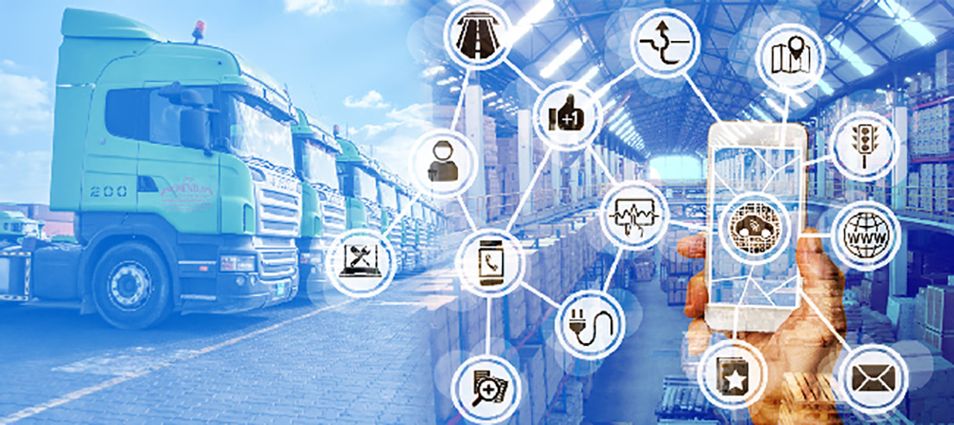
Fleet Management
An IoT-enabled fleet management solution helps businesses gain competitive advantages by automating processes in a cloud-based platform and providing real-time visibility into everything that goes on in the field.

Slide 24
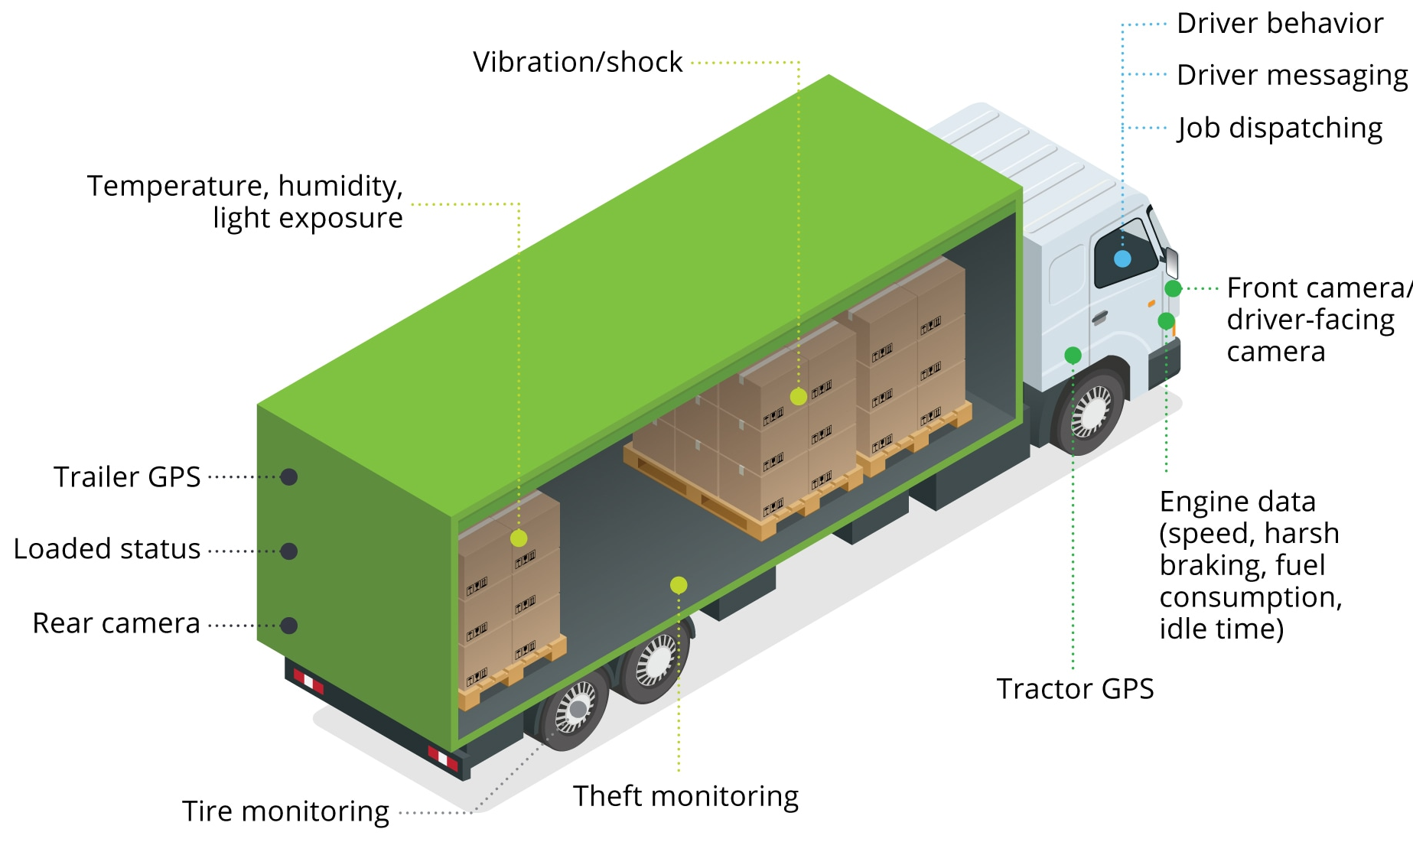
Fleet Management
Examples:
1. UPS collects GPS & IoT sensor
to minimize the number of fixes
2. Drivers’ driving habits:
Aggressive or not
3. Inventory and warehouse management
4. Supply chain management

Slide 25
Fleet Management
Possible topics:
Supply chain shortage
Security and Privacy

Slide 26
Algorithms
Reinforcement Learning

Slide 27
Previous Lectures
Supervised learning
classification, regression
Unsupervised learning
clustering
Reinforcement learning
more general than supervised/unsupervised learning
learn from interaction w/ environment to achieve a goal
environment
reward
new state
action
agent

Slide 28
Today
examples
defining an RL problem
Markov Decision Processes
solving an RL problem
Dynamic Programming
Monte Carlo methods
Temporal-Difference learning

Slide 29
Robot in a room
actions: UP, DOWN, LEFT, RIGHT
UP
80% move UP
10% move LEFT
10% move RIGHT
 |  |  | +1
 |  |  | -1
START
reward +1 at [4,3], -1 at [4,2]
reward -0.04 for each step
what’s the strategy to achieve max reward?
what if the actions were deterministic?
Notes:
want to learn a policy (what’s the solution?)
can we learn it using (un)supervised learning? why not?
so how do we learn it? any ideas?
let the robot explore the environment

Slide 30
Other examples
CarPole-balancing (simulate using open AI Gym)
no teacher who would say “good” or “bad”
is reward “10” good or bad?
rewards could be delayed
similar to control theory
more general, fewer constraints
explore the environment and learn from experience
not just blind search, try to be smart about it

Slide 31
Outline
examples
Markov Decision Processes
solving an RL problem
Dynamic Programming
Monte Carlo methods
Temporal-Difference learning

Slide 32
Robot in a room
 |  |  | +1
 |  |  | -1
START
actions: UP, DOWN, LEFT, RIGHT
UP
80% move UP
10% move LEFT
10% move RIGHT
reward +1 at [4,3], -1 at [4,2]
reward -0.04 for each step
states
actions
Rewards
what is the solution?
Notes:
want to learn a policy (what’s the solution?)
can we learn it using (un)supervised learning? why not?
so how do we learn it? any ideas?
let the robot explore the environment

Slide 33
Is this a solution?
only if actions deterministic
not in this case (actions are stochastic)
solution/policy
mapping from each state to an action
 |  |  | +1
 |  |  | -1

Slide 34
Markov Decision Process (MDP)
set of states S, set of actions A, initial state S₀
transition model P(s,a,s’)
P( [1,1], up, [1,2] ) = 0.8
reward function r(s)
r( [4,3] ) = +1
goal: maximize cumulative reward in the long run
policy: mapping from S to A
π(s) or π(s,a) (deterministic vs. stochastic)
reinforcement learning
transitions and rewards usually not available
how to change the policy based on experience
how to explore the environment
environment
reward
new state
action
agent

Slide 35
Computing return from rewards
episodic (vs. continuing) tasks
“game over” after N steps
optimal policy depends on N; harder to analyze
additive rewards
V(s₀, s₁, …) = r(s₀) + r(s₁) + r(s₂) + …
infinite value for continuing tasks
discounted rewards
V(s₀, s₁, …) = r(s₀) + γ*r(s₁) + γ²*r(s₂) + …
value bounded if rewards bounded

Slide 36
Discounted Rewards
Rewards in the future are worth less than an immediate reward
Because of uncertainty: who knows if/when you’re going to get to that reward state
Notes:
Sum to inf

Slide 37
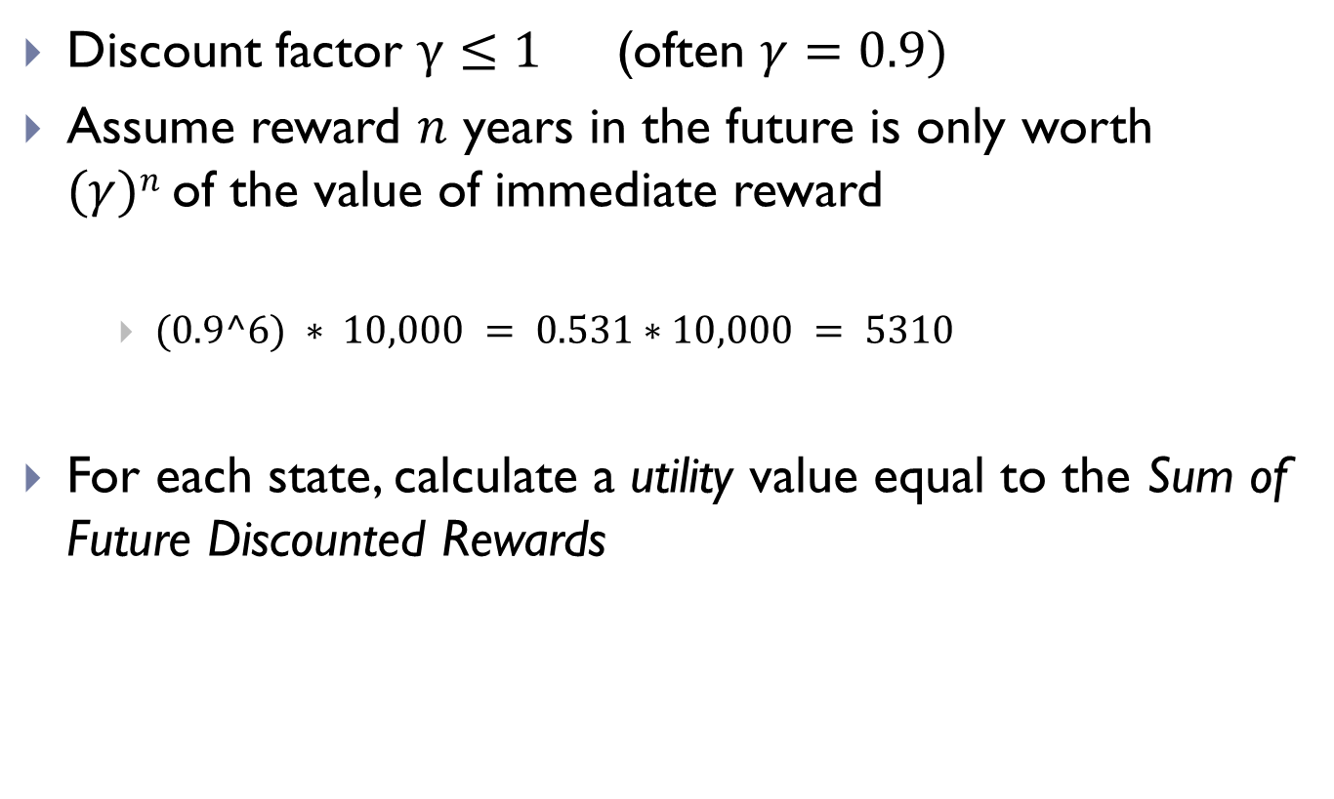
Discounted Rewards
Discount factor $γ≤1$ (often $γ=0.9)$
Assume reward $n$ years in the future is only worth $(γ)n$of the value of immediate reward
$(0.9^6) ∗ 10,000 = 0.531∗10,000 = 5310$
For each state, calculate a utility value equal to the Sum of Future Discounted Rewards

Slide 38
Value functions
state value function: V^{π}(s)
expected return when starting in s and following π
state-action value function: Q^{π}(s,a)
expected return when starting in s, performing a, and following π
useful for finding the optimal policy
can estimate from experience
pick the best action using Q^{π}(s,a)
Bellman equation
s
a
r
s’

Slide 39
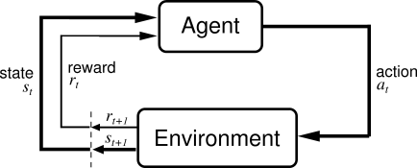
Reinforcement Learning
Basic idea:
Receive feedback in the form of rewards
Agent’s utility is defined by the reward function
Must (learn to) act so as to maximize expected rewards

Slide 40
Reinforcement Learning (RL)
RL algorithms attempt to find a policy for maximizing cumulative reward for the agent over the course of the problem.
Typically represented by a Markov Decision Process
RL differs from supervised learning in that correct input/output pairs are never presented, nor sub-optimal actions explicitly corrected.

Slide 41


What is Markov about MDPs?
Andrey Markov (1856-1922)
“Markov” generally means that given the present state, the future and the past are independent
For Markov decision processes, “Markov” means:

Slide 42
Solving MDPs
In deterministic single-agent search problems, want an optimal plan, or sequence of actions, from start to a goal
In an MDP, we want an optimal policy π*: S → A
A policy π gives an action for each state
An optimal policy maximizes expected utility if followed
Defines a reflex agent
Optimal policy when R(s, a, s’) = -0.03 for all non-terminals s

Slide 43
Recap: Defining MDPs
s
Markov decision processes:
States S
Start state s₀
Actions A
Transitions P(s’|s,a) (or T(s,a,s’))
Rewards R(s,a,s’) (and discount γ)
MDP quantities so far:
Policy = Choice of action for each state
Utility (or return) = sum of discounted rewards
a
s, a
s,a,s’
s’

Slide 44
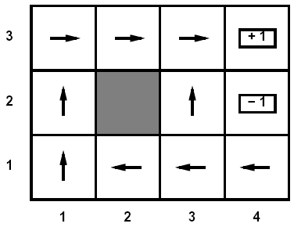
Optimal Utilities
Fundamental operation: compute the values (optimal expect max utilities) of states s
Why? Optimal values define optimal policies!
Define the value of a state s:
V*(s) = expected utility starting in s and acting optimally
Define the value of a q-state (s,a):
Q*(s,a) = expected utility starting in s, taking action a and thereafter acting optimally
Define the optimal policy:
π*(s) = optimal action from state s
s
a
s, a
s,a,s’
s’

Slide 45
Value Iteration
Idea:
Start with V₀*(s) = 0, which we know is right (why?)
Given V_{i}*, calculate the values for all states for depth i+1:
This is called a value update or Bellman update
Repeat until convergence
Theorem: will converge to unique optimal values
Basic idea: approximations get refined towards optimal values
Policy may converge long before values do

Slide 46
Outline
examples
Markov Decision Processes
Reinforcement learning

Slide 47
Reinforcement Learning
Reinforcement learning:
Still assume an MDP:
A set of states s ∈ S
A set of actions (per state) A
A model T(s,a,s’)
A reward function R(s,a,s’)
A discount factor γ (could be 1)
Still looking for a policy π(s)
New twist: don’t know T or R
i.e. don’t know which states are good or what the actions do
Must actually try actions and states out to learn

Slide 48
The Story So Far: MDPs and RL
Things we know how to do:
Techniques:
If we know the MDP
Compute V*, Q*, π* exactly
Evaluate a fixed policy π
If we don’t know the MDP
We can estimate the MDP then solve
We can estimate V for a fixed policy π
We can estimate Q*(s,a) for the optimal policy while executing an exploration policy
Model-based DPs
Value and policy Iteration
Policy evaluation
Model-based RL
Model-free RL:
Value learning
Q-learning

Slide 49
Passive Learning
Simplified task
You don’t know the transitions T(s,a,s’)
You don’t know the rewards R(s,a,s’)
You are given a policy π(s)
Goal: learn the state values
… what policy evaluation did
In this case:
Learner “along for the ride”
No choice about what actions to take
Just execute the policy and learn from experience
We’ll get to the active case soon
This is NOT offline planning! You actually take actions in the world and see what happens…

Slide 50
Model-Based Learning
Idea:
Learn the model empirically through experience
Solve for values as if the learned model were correct
Simple empirical model learning
Count outcomes for each s,a
Normalize to give estimate of T(s,a,s’)
Discover R(s,a,s’) when we experience (s,a,s’)
Solving the MDP with the learned model
Iterative policy evaluation, for example
s
π(s)
s, π(s)
s, π(s),s’
s’

Slide 51
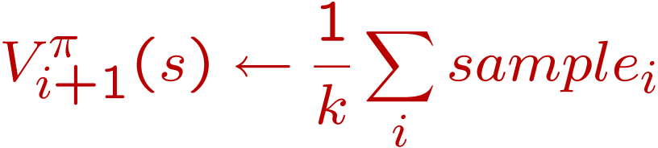
Sample-Based Policy Evaluation?
Who needs T and R? Approximate the expectation with samples (drawn from T!)
s
π(s)
s, π(s)
s, π(s),s’
s₂’
s₁’
s₃’
Almost! But we only actually make progress when we move to i+1.

Slide 52
Temporal-Difference Learning
s
π(s)
Big idea: learn from every experience!
Update V(s) each time we experience (s,a,s’,r)
Likely s’ will contribute updates more often
Temporal difference learning
Policy still fixed!
Move values toward value of whatever successor occurs: running average!
s, π(s)
s’
Sample of V(s):
Update to V(s):
Same update:

Slide 53
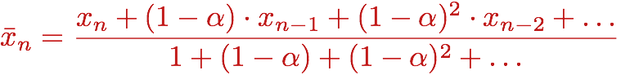
Exponential Moving Average
Exponential moving average
Makes recent samples more important
Forgets about the past (distant past values were wrong anyway)
Easy to compute from the running average
Decreasing learning rate can give converging averages

Slide 54
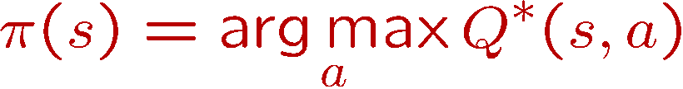
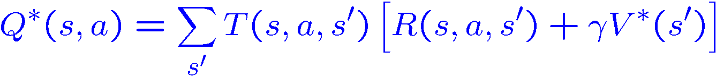
Problems with TD Value Learning
TD value leaning is a model-free way to do policy evaluation
However, if we want to turn values into a (new) policy, we’re sunk:
Idea: learn Q-values directly
Makes action selection model-free too!
s
a
s, a
s,a,s’
s’

Slide 55
Active Learning
Full reinforcement learning
You don’t know the transitions T(s,a,s’)
You don’t know the rewards R(s,a,s’)
You can choose any actions you like
Goal: learn the optimal policy
… what value iteration did!
In this case:
Learner makes choices!
Fundamental tradeoff: exploration vs. exploitation
This is NOT offline planning! You actually take actions in the world and find out what happens…

Slide 56
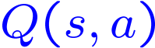
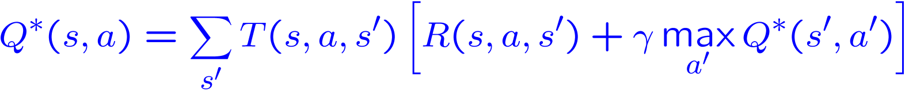
Model free learning: Q-Learning
Q-Learning: sample-based Q-value iteration
Learn Q*(s,a) values
Receive a sample (s,a,s’,r)
Consider your old estimate:
Consider your new sample estimate:
Incorporate the new estimate into a running average:

Slide 57
Q-Learning Properties
Amazing result: Q-learning converges to optimal policy
If you explore enough
If you make the learning rate small enough
… but not decrease it too quickly!
Basically doesn’t matter how you select actions (!)
Neat property: off-policy learning
learn optimal policy without following it (some caveats)
S |  |  |  |  |  | E
S |  |  |  |  |  | E

Slide 58
Exploration / Exploitation
Several schemes for forcing exploration
Simplest: random actions (ε greedy)
Every time step, flip a coin
With probability ε, act randomly
With probability 1-ε, act according to current policy
Problems with random actions?
You do explore the space, but keep thrashing around once learning is done
One solution: lower ε over time
Another solution: exploration functions

Slide 59
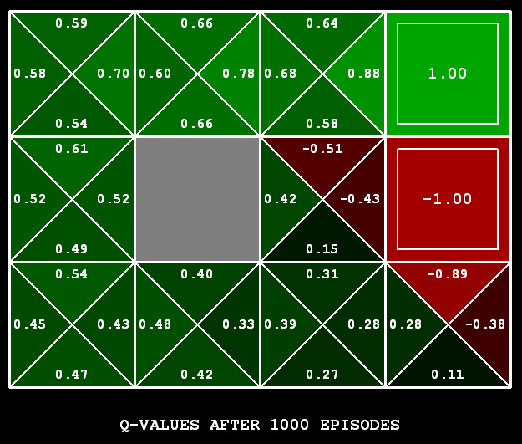
Q-Learning
Q-learning produces tables of q-values:

Slide 60
Learning from demonstration
Humans are working models of control and policy learning
Leverage human tutelage and/or performance to build robot controllers
Can involve supervised, unsupervised and/or reinforcement learning
Video

Slide 63
The Story So Far: MDPs and RL
Things we know how to do:
Techniques:
If we know the MDP
Compute V*, Q*, π* exactly
Evaluate a fixed policy π
If we don’t know the MDP
We can estimate the MDP then solve
We can estimate V for a fixed policy π
We can estimate Q*(s,a) for the optimal policy while executing an exploration policy
Model-based DPs
Value and policy Iteration
Policy evaluation
Model-based RL
Model-free RL:
Value learning
Q-learning

Slide 64
Q-Learning
In realistic situations, we cannot possibly learn about every single state!
Too many states to visit them all in training
Too many states to hold the q-tables in memory
Instead, we want to generalize:
Learn about some small number of training states from experience
Generalize that experience to new, similar states
This is a fundamental idea in machine learning, and we’ll see it over and over again

Slide 65
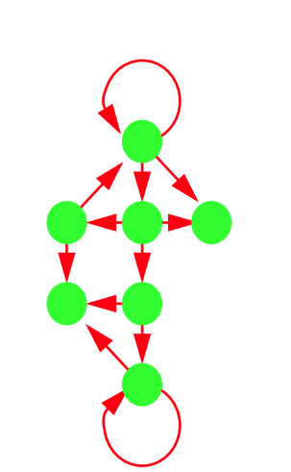
Inverse Reinforcement Learning (IRL) - Definitions
0.7
A Markov Decision Process (MDP) model contains:
A set of possible states S
A set of possible actions A
A real valued reward function R(s, a)
A transition matrix P
0.2
Notes:
Green: states
Red arrows: actions
Reward based on each action in a state
0.7, 0.2: probabilities in a transition matrix

Slide 66
Inverse Reinforcement Learning (IRL) - RL
Reinforcement Learning (RL):

Slide 67
Inverse Reinforcement Learning (IRL) – RL v.s. IRL
Notes:
Unlike other IRL research, which learns from imitation to recreate expert moves, we learn from mimicry to capture and analyze a model of human behavior.
To model human behavior from ambient sensor data, we propose an approach that is based on inverse reinforcement learning (IRL).
IRL is a machine learning technique that mimics observed behavior. In this study, our proposed algorithm mimics the behavior of a smart home resident based on sensor-observed navigation patterns within a home environment.
Unlike other IRL research, which learns from imitation to recreate expert moves, we learn from mimicry to capture and analyze a model of human behavior.
Note: the significance of learning the rewards: learn the preference differences on different subgroups.

Slide 68
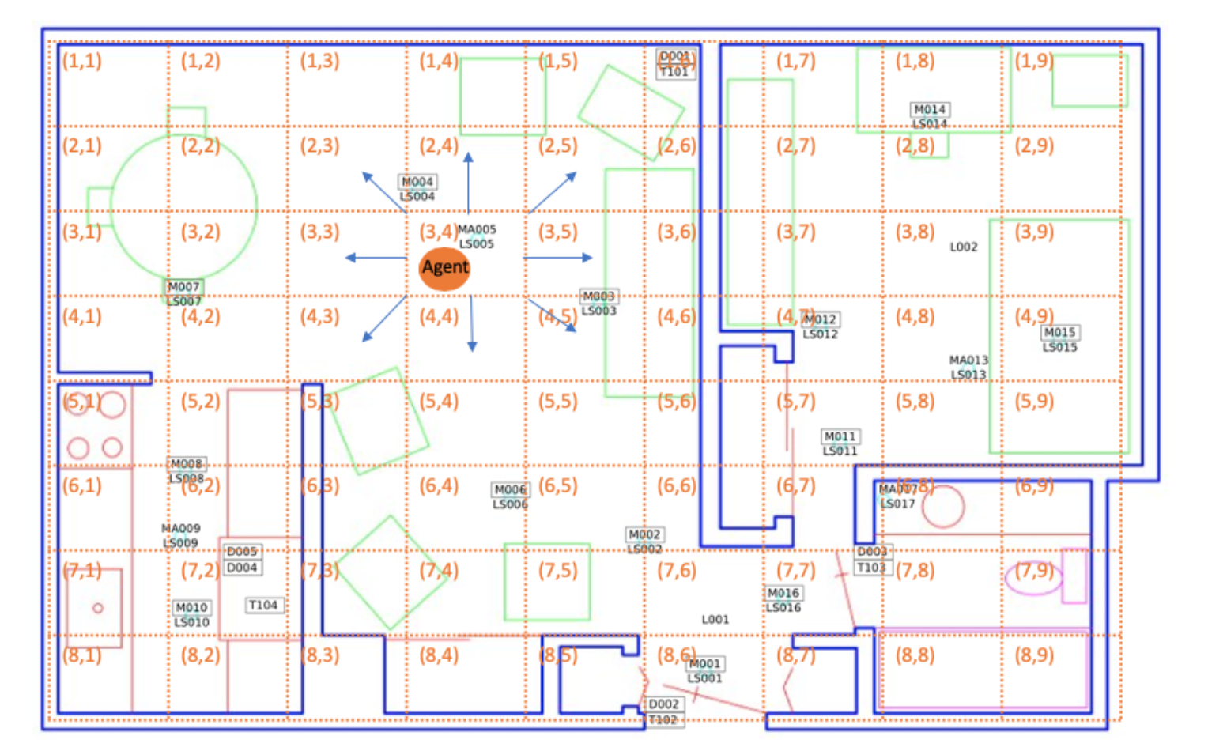
Inverse Reinforcement Learning (IRL) of Indoor Behavior – Navigation
d_toilet | d_bathroom_sink | d_livingroom_chair | d_kitchen_sink
d_bedroom | d_kitchen | d_livingroom | d_hallway
d_stove | d_office_chair | o_toilet | o_livingroom_chair
o_kitchen_sink | o_office_chair
Notes:
Table is the features:
feature names prefixed by “d : the duration that the resident stays at a location
feature names prefixed by “o_”: the overall activity/movement level at a location

Slide 69
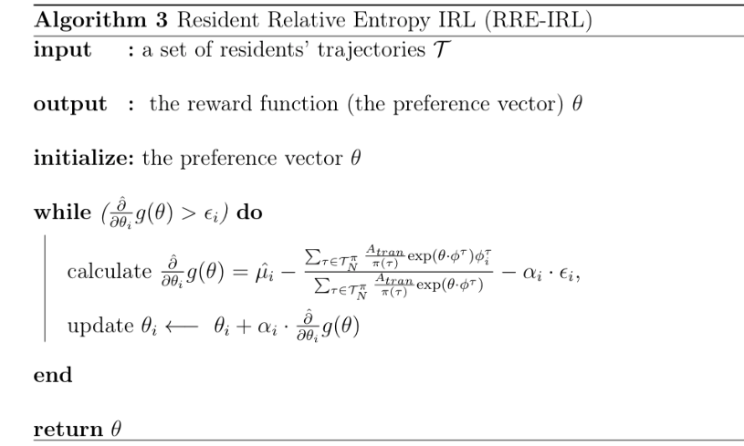
Inverse Reinforcement Learning (IRL) of Indoor Behavior – Algorithm
:
Notes:
IRL is an optimization problem. To solve it, there are two steps:
1. introducing Lagrange multipliers to have a Lagrangian
2. solving a Lagrange dual function g
Note: \hat{\partial} g(\theta) is the gradient of the dual function g.
\hat{\partial} g(\theta) : gradient estimation based on trajectories.
1. \hat{u_i}: feature expectations
2. A_tran: join probability of the actions executed on the states in trajectories.

Slide 70
Data Types

